Slide 1

Tweet Generation 101
Margarita Maligaya • Shay Green

Slide 2


Overview
Your opinion online has value
Product Reviews
Social Media
Companies and individuals can gain from this new “sense” users have
How easy is it for an individual to generate their own tweets?
How much or little does someone need to know about computers to start benefiting from this technology?
Notes:
Margarita
Your opinion online is worth something:
When you leave a 5 star review on a product on Amazon, someone out there is reading it and possibly trusting you
If you see tons of tweets about how bad a restaurant is, you will probably not want to go to that restaurant
Of course, there is something to gain from this.
Companies can begin to curate tweets to their own benefits, but we wanted to see how easy it was for an individual at home to obtain this technology
So we ask the questions:
How easy is it really for someone to generate their own tweets?
How much or little do they need to know about computers to start benefiting?

Slide 3
Process
Grab tweets containing a specific keyword with a 1000 limit
Categorize tweets as positive, negative, or neutral
Generate tweets at each training epoch for temperature 0.2, 0.5, 1.0
Gather Data
Clean Tweets
Sentiment Analysis
Model Training
Generate
Strip tweets of emojis, Unicode, and other special characters
Train textgenrnn language generation model on classified tweets
Notes:
Shay
After looking through the internet for resources readily available, we began our implementation
Gather data: Implemented library code from github, exclude links, language = english, location (for more english tweets)
Clean tweets: Implemented functions from geeksforgeeks and github to remove special characters
Sentiment Analysis: Implemented TextBlob sentiment analysis code via geeksforgeeks to classify the training data
Model training: Used textgenrnn python model via github code for text generation model trained on sentiment and keyword specific data
Generation: Output text samples at each training epoch for various temperatures to evaluate model performance

Slide 4
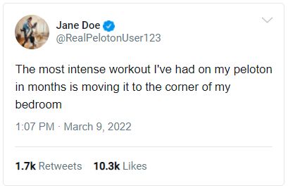
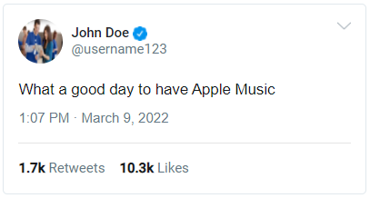


Results
Notes:
Margarita
These tweets were generated after at least 15 training epochs
Some direct repetitions of the training tweets, but believable tweets can be generated
Goes to show that realistic tweets can feasibly be generated, but creativity and variance in the generated tweets is much more difficult

Slide 5

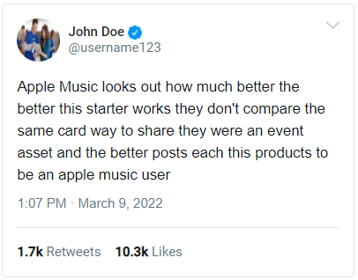

Results
Notes:
Margarita
Picked tweets that were generated during the same epoch as the good tweets generated but with a higher temperature
No longer direct repetition, and better than the tweets that outputted nonsensical words, but still not believable results
Shows that we need more training data to improve our generated tweets

Slide 6
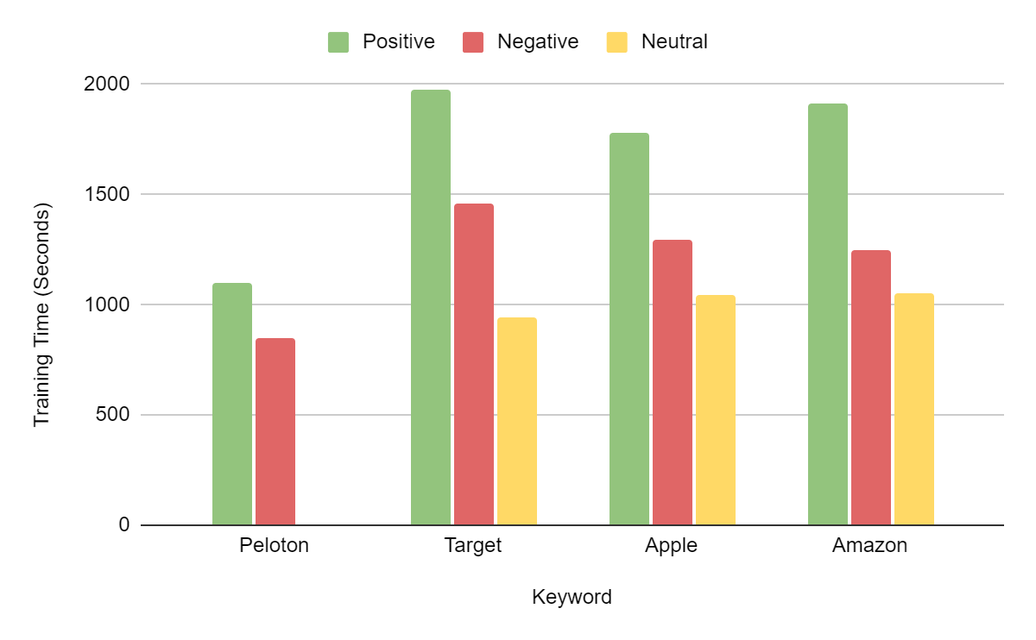
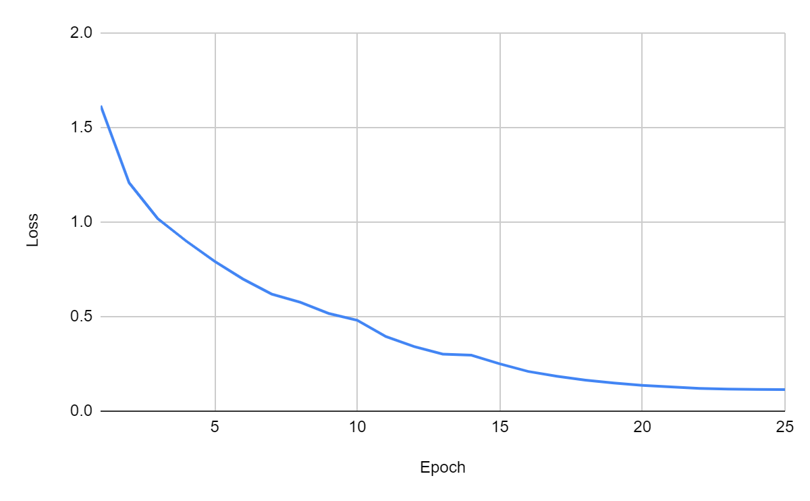
Results
Training Time
Loss
10 epochs (passes) = max 30 minutes
25 epochs = max 1 hour
Time was proportional to number of samples
Loss over 25 epochs
More epochs generated more realistic text, but increased the amount of memorization
Notes:
Shay
Our first experiments were training for 10 epochs for anywhere between 400 training samples to only 20.
The amount of time for training was proportional to the number of samples that we had access to for training ranging from 15 or 20 minutes to about a half an hour.
Finally we did experiments for 25 epochs and you can see in the graph on the right the loss per epoch for that training, which took upward of about an hour to complete.
As you can see, we achieved fairly good loss results at around 15 epochs where we were outputting tweets that had proper spelling and could conceivably be sentences, but didn’t quite make sense.
At that point though, we also saw the massive overfitting that achieved rote memorization and repetition at lower temperatures.

Slide 7
Insights
Future Work
Data: Library used provided very few examples which resulted in overfitting to the data that we trained on
Context: Keywords can describe more than just a products/brands
Take into account the social context of the keyword
Sentiment: Data must be labeled accurately in order for the model to be effective
“lowkey this android is better than my iPhone 👀”
Knowledge: Individuals who take on this project do need a basic understanding of Python and/or computers
Can be found online
Product Reviews:
More likely to have an obvious sentiment
Longer and more structured sentences
Process:
Verifying labeling sentiments
Pre and post cleaning of data
Crowdsourcing opinions of results
Notes:
Insights: Shay, Future Works: Margarita
Using the library that we used, we only had access to a limited number of tweets, we needed more data to be able to produce more unique/creative tweets and avoid overfitting. Potential future works could include using the Twitter API to gain access to more training data
Many keywords describe more than just products or brands. Being aware of the political or social connotations of these keywords can help avoid gathering tweets that are about other topics
Target → Ukraine
Apple music when spotify was down
This process relies on accurate sentiment analysis of the training data. Inaccuracies in the upstream processing of our training data is perpetuated through the model to the output generated
Sentiment/regard: not all of the tweets were labeled correctly: keyword=’IPhone’ “lowkey this android is better than my iPhone 👀” → positive sentiment but negative regard for IPhone
Future work: applications in product reviews (better textual structure and ability to determine the sentiment)
Future work: making sure our sentiment analysis is accurate, cleaning data (emoijs/etc. contribute to the meaning) and adding things back in afterwards, gathering annotations on whether the outputted tweets are believable, the correct sentiment, and about the correct keyword → more statistics on model accuracy

Slide 8

Notes:
Try it out yourself if you want!

Slide 9
Discussion
As a developer, be cautious about your data and how you use it
This technology can be easily misused
As a user, be careful of how you perceive things online
If two students can learn how to generate tweets in less than a week, then what can corporations do with tons of resources and an actual motive?

